Slide 1
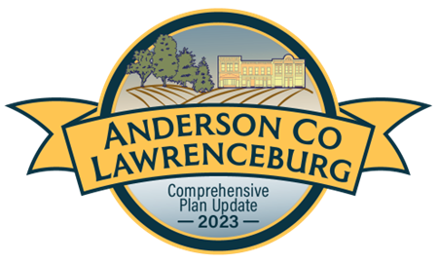
Proposed Comprehensive Plan Changes
2023 Anderson County and Lawrenceburg Planning Commission Comprehensive Plan Update

Slide 2
WHAT IS COMPREHENSIVE
PLANNING?

Slide 3
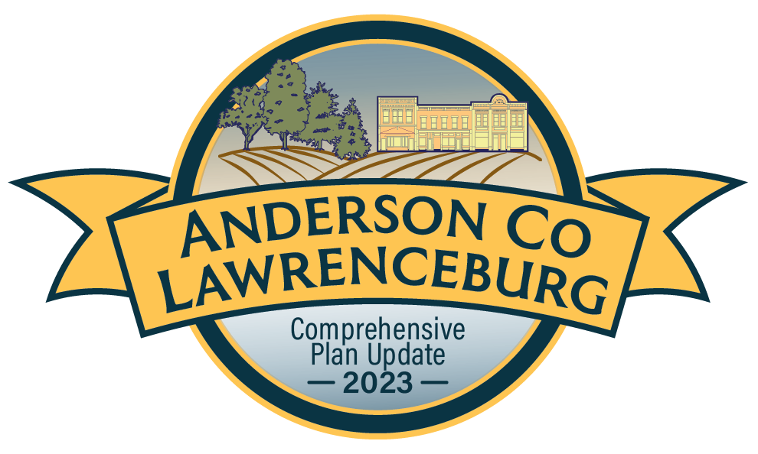
The planning commission of each unit shall prepare a comprehensive plan, which shall serve as a guide for public and private actions and decisions to assure the development of public and private property in the most appropriate relationships.
KRS 100.183

Slide 4
What is a Comprehensive Plan
A plan that outlines a community’s long-term vision and goals for development and growth.
A roadmap for decision-making and a guide for future land use decisions.
Typically covers a wide range of topics, reflecting the unique characteristics and challenges of the area.
A long-term plan that looks ahead for the next 10, 20, or even 30 years.
Must be readopted or amended every 5 years according to KRS 100.197

Slide 5
Comprehensive Planning Myths
Comprehensive plans dictate what goes where
Comprehensive Plans state goals and objectives, policies, and the vision for future development.
A Comprehensive Plan is rigid and inflexible
The plan can be amended at any time and is required to be readopted or amended every 5 years.
The Comprehensive plan changes zoning
The Comprehensive Plan does not affect the current zoning for any properties. It can serve as a guide for future zoning decisions by outlining the vision for the future, but zoning is a tool to implement the Comprehensive Plan, not the other way around.

Slide 6
KRS Requirements
Goals and Objectives – serve as a guide for the physical development and economic and social well-being of the planning unit.
Land Use Element – shall show proposals for the most appropriate, economic, desirable, and feasible patterns for the general location, character, extend, and interrelationship of the manner in which the community should use its public and private land at a specified times as far into the future as is reasonable to foresee.
Transportation Element – which shall show proposals for the most desirable, appropriate, economic, and feasible pattern for the general location, character, and extent of the channels, routes, and terminals for transportation facilities for the circulation of persons and goods for specified times as far into the future as is reasonable to foresee
Community Facilities Element – which shall which shall show proposals for the most desirable, appropriate, economic, and feasible pattern for the general location, character, and the extent of public and semipublic buildings, land, and facilities for specified times as far into the future as is reasonable to foresee.
KRS 100.183

Slide 7
Other Elements:
The comprehensive plan may include any additional elements such as, without being limited to, community renewal, housing, flood control, pollution, conservation, natural resources, regional impact, historic preservation, and other programs which in the judgment of the planning commission will further serve the purposes of the comprehensive plan.
KRS 100.187
What is proposed to be included:
Economic Development
Historical and Natural Resource Preservation
Housing
Implementation

Slide 8
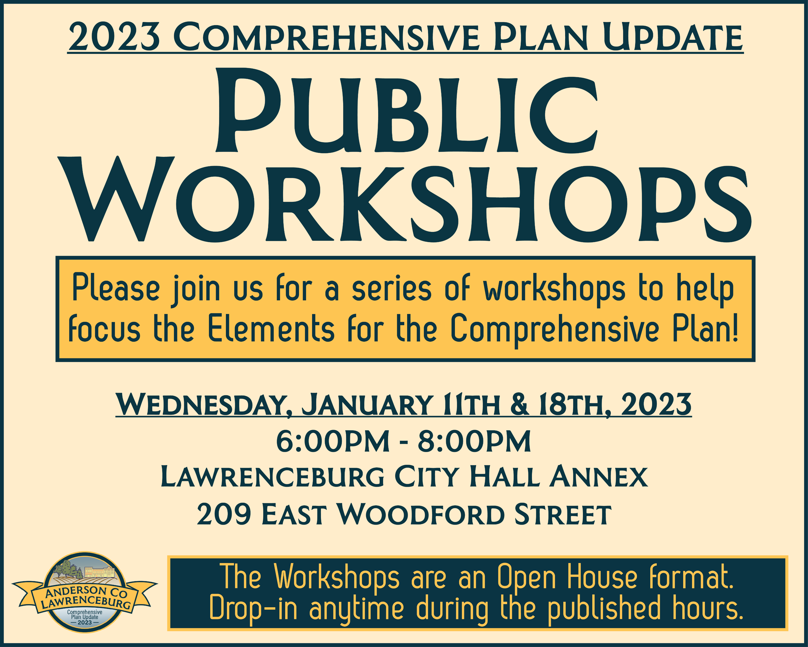
Planning Process
Began in April 2022
Monthly Steering Committee Meetings through March 2023
Public hearing for the adoption of the Goals and Objectives
Online survey
Two public workshops

Slide 9
Goals and Objectives

Slide 13
Proposed Changes

Slide 14
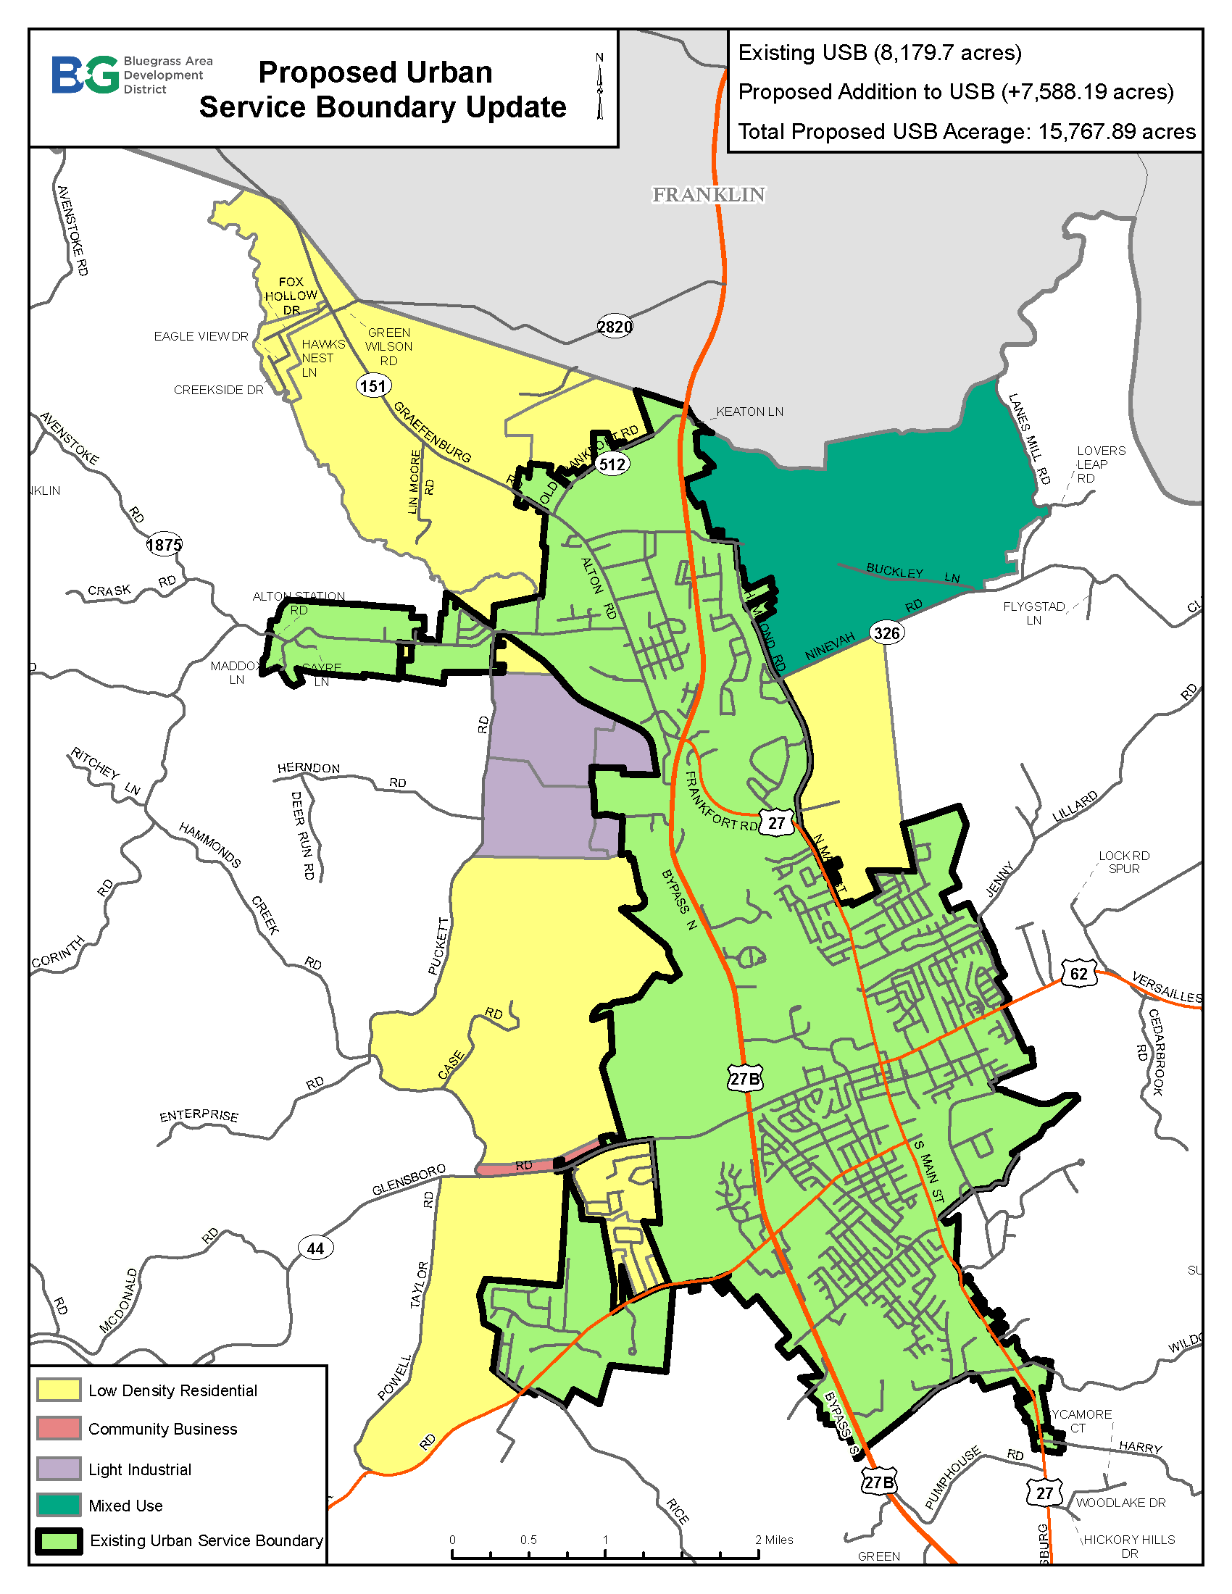
Urban
Service
Boundary

Slide 15
Changes from 2017 Comp Plan
Major expansion to the Urban Service Boundary
Mix of adding new, undeveloped land and a better representation of current and future utility expansion.
Most of the addition will be for residential growth, with some industrial, commercial, and mixed-use developments

Slide 16
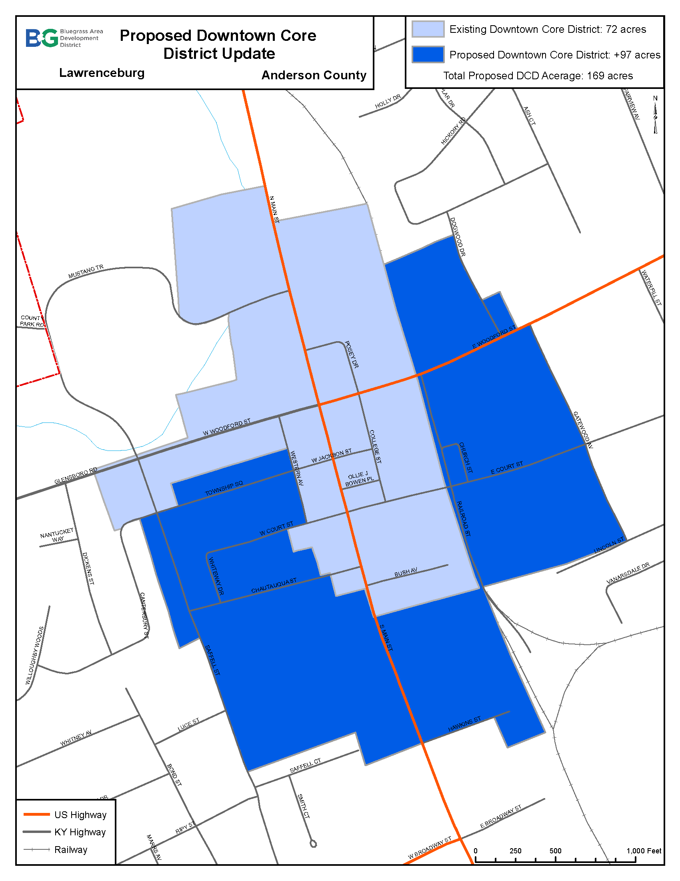
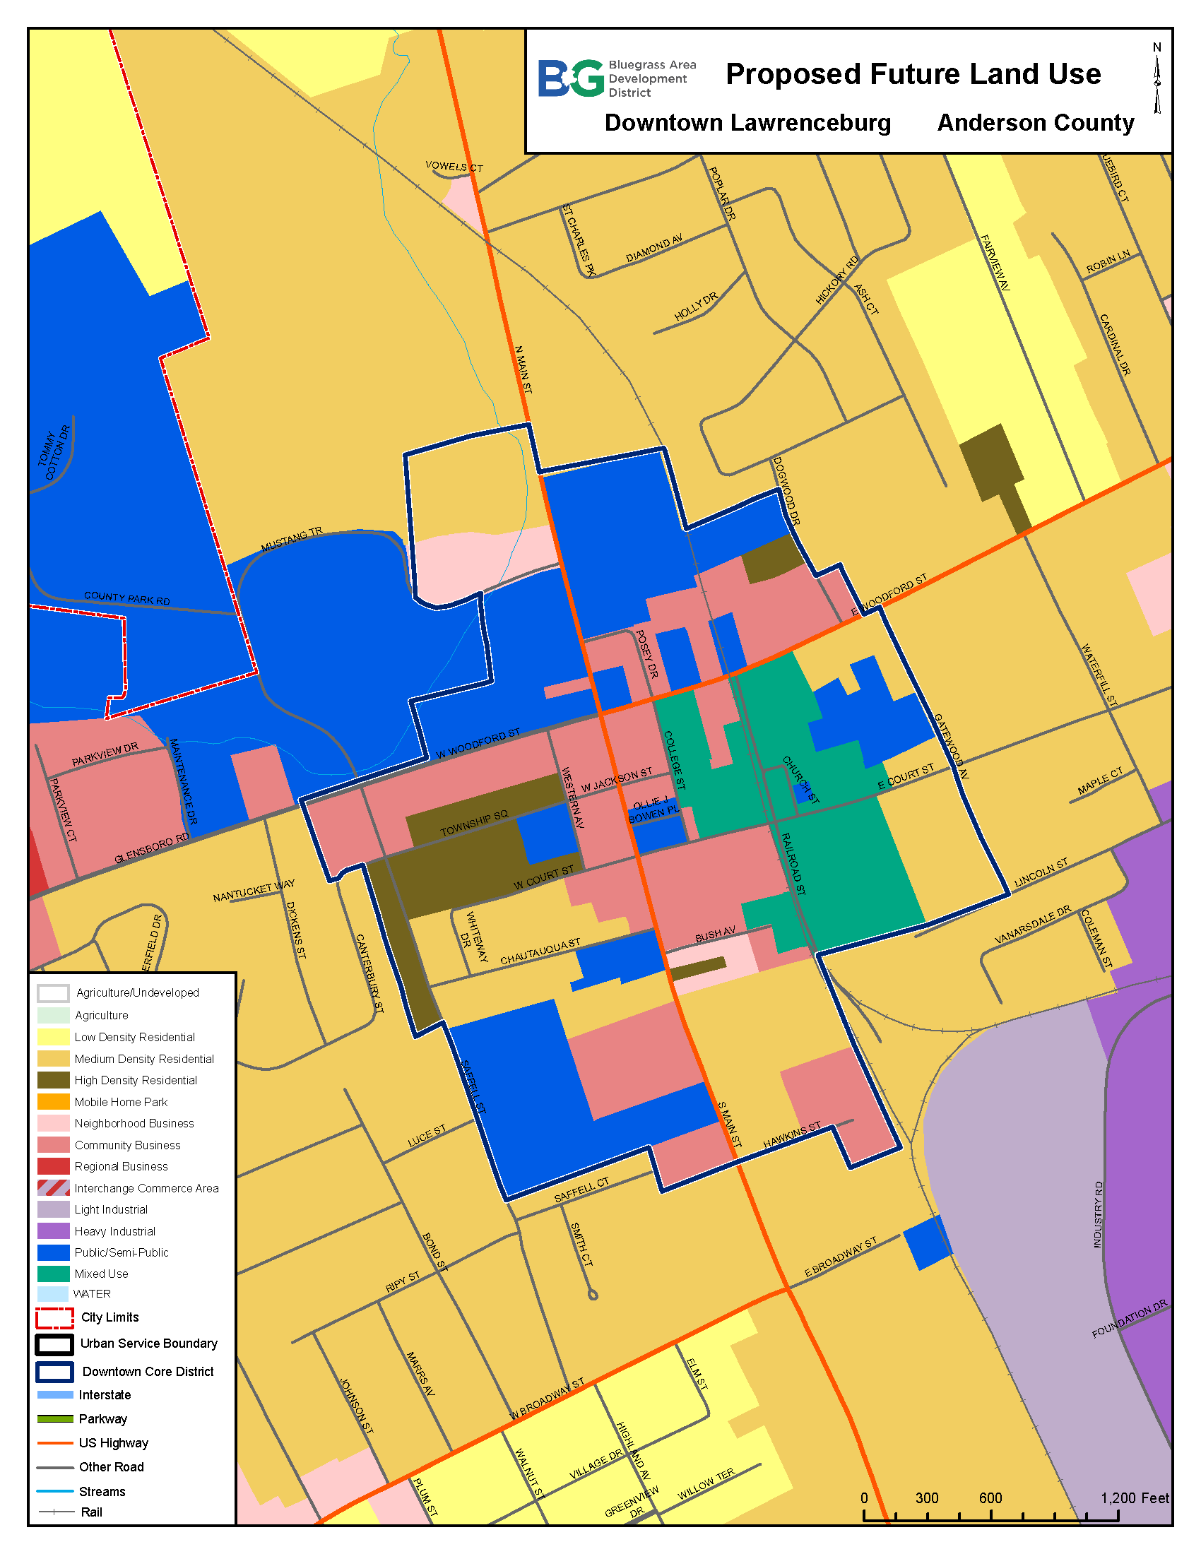
Downtown Updates

Slide 17
Downtown Changes
Expansion of what is considered “downtown” for future planning.
Removal of industrial future land uses.
Inclusion of mixed-use development for increased development flexibility.

Slide 18
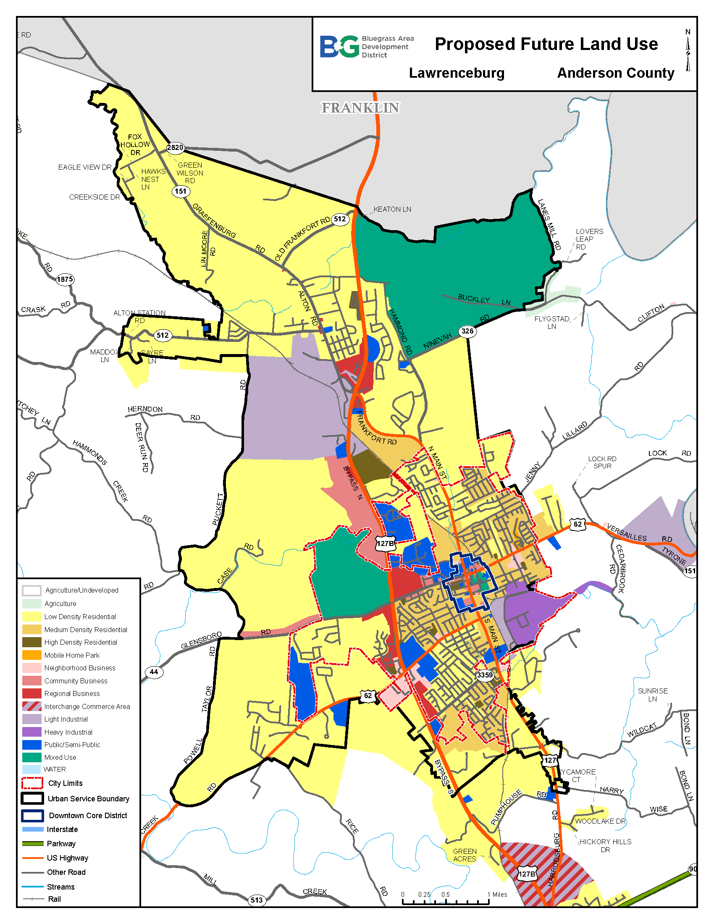
Land Use –
USB

Slide 19
Proposed Land Use Changes
151 corridor is a low-density residential area
Matching 127 development with Franklin County
Utility expansion
Kentucky Bourbon Trail – rural character and entrance to the community
Expanding industrial use surrounding Florida Tile
Added mixed-use as a way to be more flexible with development
Major expansion of residential development

Slide 20
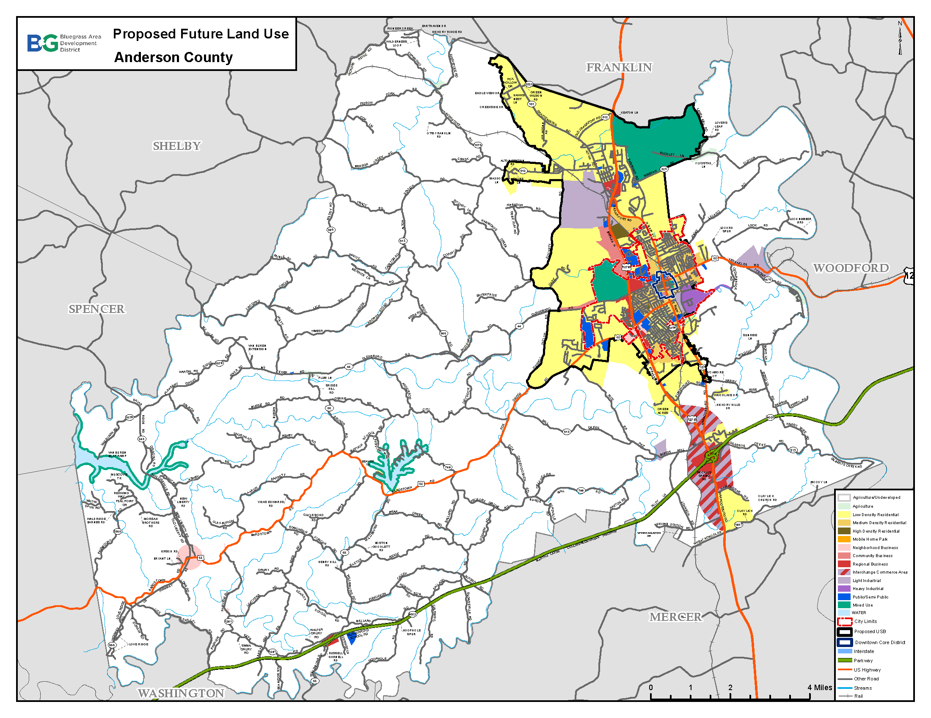
Land Use – Anderson County

Slide 21
Land Use Changes
Expansion of the USB north and west
Kept majority of the county as agricultural land
Preserved commercial areas at major intersections
Changed southeast corner of the Interchange Commerce Area to low-density residential to match existing development patterns
Included a mixed-use designation surrounding lakes to encourage flexible development

Slide 22
Proposed Land Use Changes
Anderson County Future Land Use Acreage Proposed Changes
 | 2017 - City | 2017 - County | Proposed 2023 – City | Proposed 2023 – County
A-1 | 0 | 109,548.1 | -19.6 | -7,279.1
A-2 | 0 | 387.4 | N/A | -210.7
Central Business | 66.8 | 298.8 | N/A | +298.8
Highway Business | 170.2 | 484.4 | N/A | -19.9
Neighborhood Business | 147.4 | 244.3 | -96.8 | +5.2
ICA | 0 | 1,154.2 | N/A | 191.9
Heavy Industrial | 224.2 | 30.7 | N/A | N/A
Light Industrial | 50.3 | 1,345.6 | -18.3 | +602.5
Mobile Home | 17.1 | 0 | N/A | N/A
Mixed Use | 484 | 1,648.6 | +484 | +1,648.6
Public/Semi-Public | 423.8 | 471.7 | N/A | N/A
Low Density Residential | 1,046.5 | 10,532.3 | -117.2 | +5,369.6
Medium Density Residential | 1,196.6 | 313.3 | +32.9 | N/A
Multifamily Residential | 42.8 | 94.5 | -118.6 | N/A

Slide 23
Next Steps
Review proposed changes
Please get comments to me by July 21
I will complete the first draft and send to the Planning Commission, City, County, and Steering Committee mailing list.
Schedule public hearing
Adoption

Slide 24
Contact:
Joe Black, Regional Land Use Planner
jblack@bgadd.org (859) 269-8021

